Slide 1


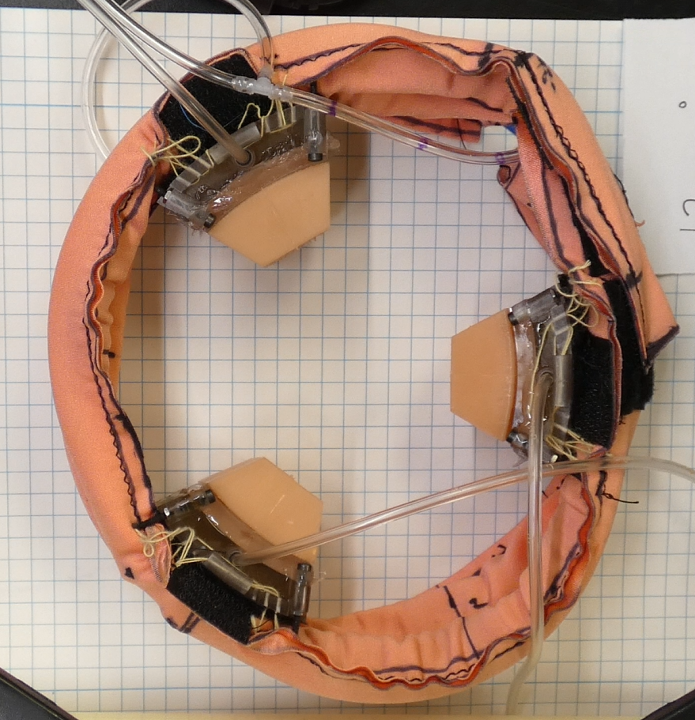
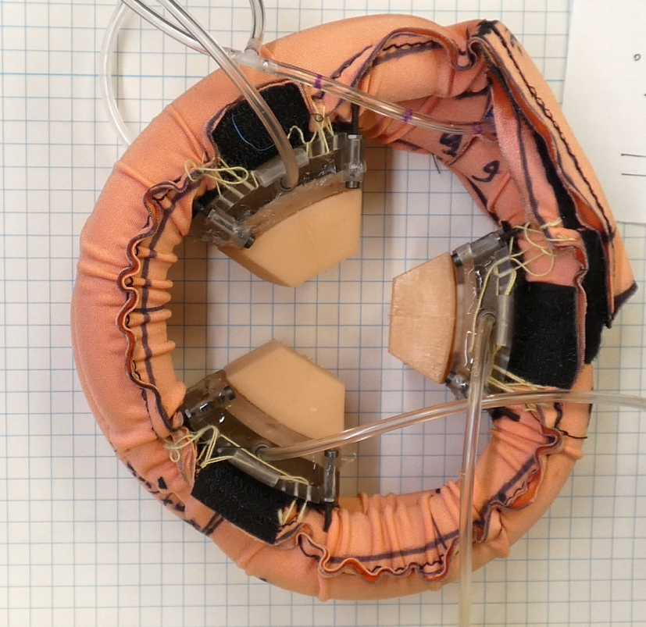
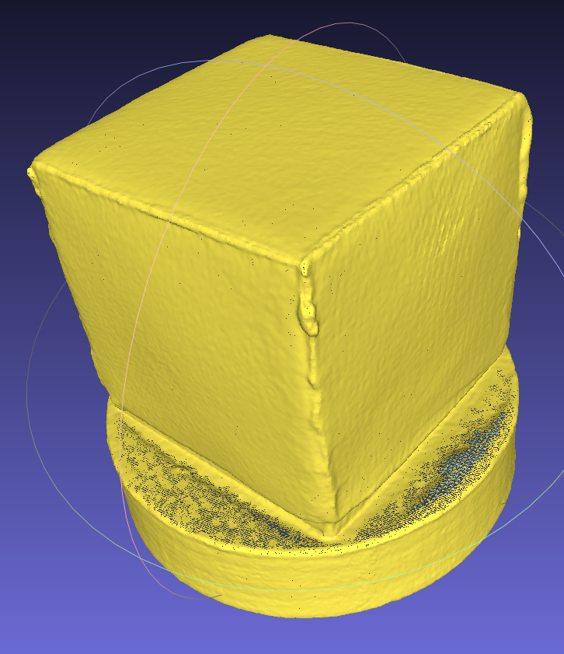
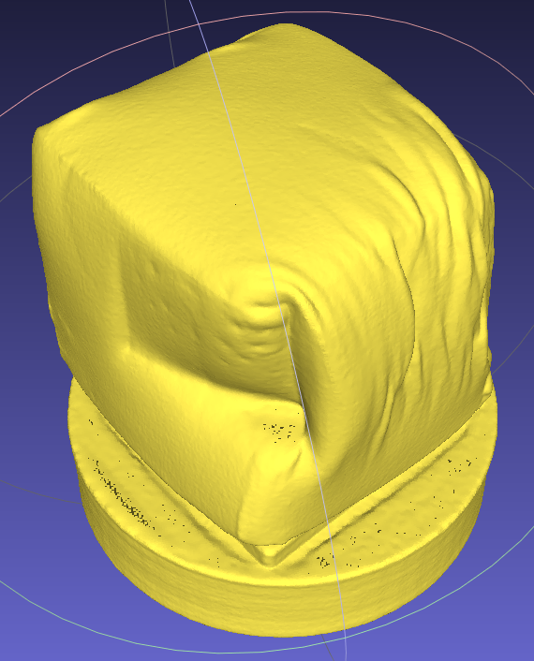
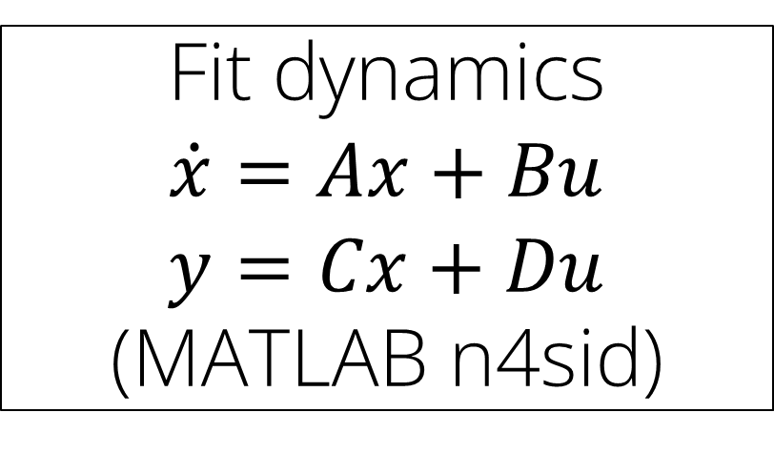

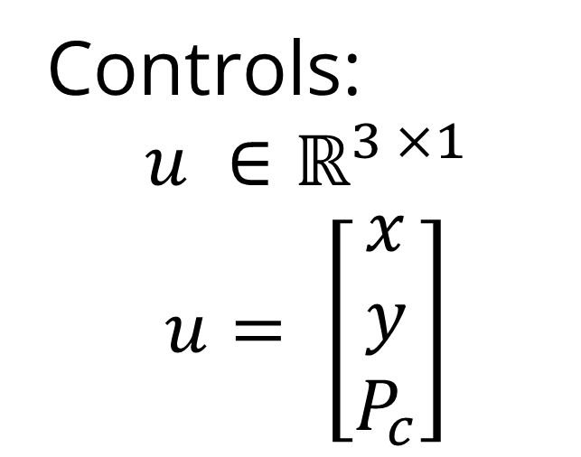
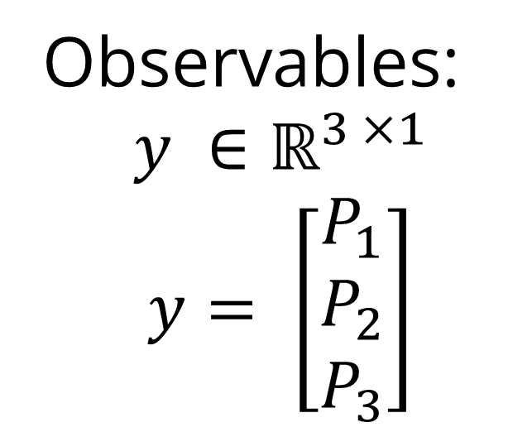
Data-Driven Control of a Soft Bioinspired Grasper
Ravesh Sukhnandan¹, Sreeram Thirupathi², Helen Wang¹, Nathan Zimmerer¹
Biohybrid and Organic Robotics Group
Carnegie Mellon University: 1) Mechanical Engineering, 2) Robotics Institute
Introduction
Methods
Results
Soft graspers have inherent advantages in handling fragile and deformable objects e.g. fruits, food, biological tissues
However, even very deformable items like soft clays may require active force control to minimize deformation
Observables:
$$y ∈ℝ^{3 ×1}$$
$$y= \left[\begin{matrix}P_{1} \\ P_{2} \\ P_{3}\end{matrix}\right]$$
Random step changes in controls
object
P₁
y
x
y
x
. . .
y
x
A
B
Controls:
$$u ∈ℝ^{3 ×1}$$
$$u= \left[\begin{matrix}x \\ y \\ P_{c}\end{matrix}\right]$$
P₃
P₂
$$P_{c}$$
1
2
N
Fig. 3: Experimental setup to gather data for fitting using random step changes in controls on a fixed cylinder (N = 58).
C
Fig. 6: Simulation with PID for quasistatic and for Koopman. Add real hardware data with PID
No force control
Undeformed clay cube
After grasp
Fig. 1: Bio-inspired soft grasper with contact sensing via pneumatic jaws [1]. The grasper decreases the enclosed area when moving from the rest state (A) to the actuated state (B). Without force control, the grasper can impart significant deformations (C).
Conclusions
Fig. 4: (a) Eigenvalue plot (Re vs Imaginary of eigenvalues), (b) Quasistatic fit
Goal: Track arbitrary contact pressure trajectories during grasping of rigid and deformable objects using optimal control techniques
Results
Future Work
Try the LQR controller on hardware and compare the result to the simulation
Gather more data for the dynamics regression:
Cylinders of different sizes
Materials of different rigidity (PLA and soft clay)
Quantify deformation induced on deformable material with LQR controller and compare to existing neural-network open-loop controller [1]
Methods
Soft graspers exhibit behaviors that are hard to analytically model e.g. non-linear material properties, hysteresis, deformable contact etc.
We use a data-driven approach to get the dynamics of the grasper so we can apply optimal control techniques.
Fit dynamics $$\dot{x}=Ax+Bu$$
$$y=Cx+Du$$
(MATLAB n4sid)
NN open-loop
LQR
Experimental Data
Fig. 5: Koopman rollout vs real data. -> train and test.
?
Design Controller:
LQR, PID
Test controller on hardware
Fig. 2: Flow chart for controller development
References
[1] R. Sukhnandan et al., LNCS, 2023

